Slide 1
JENKINS

Slide 2
DEVOPS
DevOps is a set of practices that combines software development and IT operations.
It aims to shorten the systems development life cycle and provide continuous delivery with high software quality.
DevOps is complementary with Agile software development.
several DevOps aspects came from the Agile methodology.

Slide 3
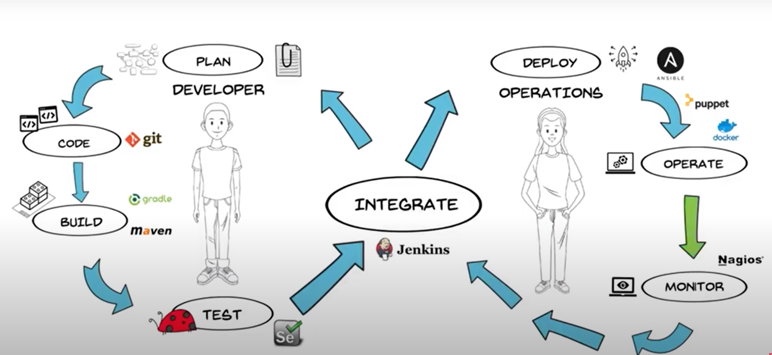
PHASES OF DEVOPS

Slide 4
AGENDA
Before Jenkins.
Issues before Jenkins.
Jenkins History.
What is Jenkins.
What is continuous integration.
Features of Jenkins.
Jenkins Architecture.

Slide 5
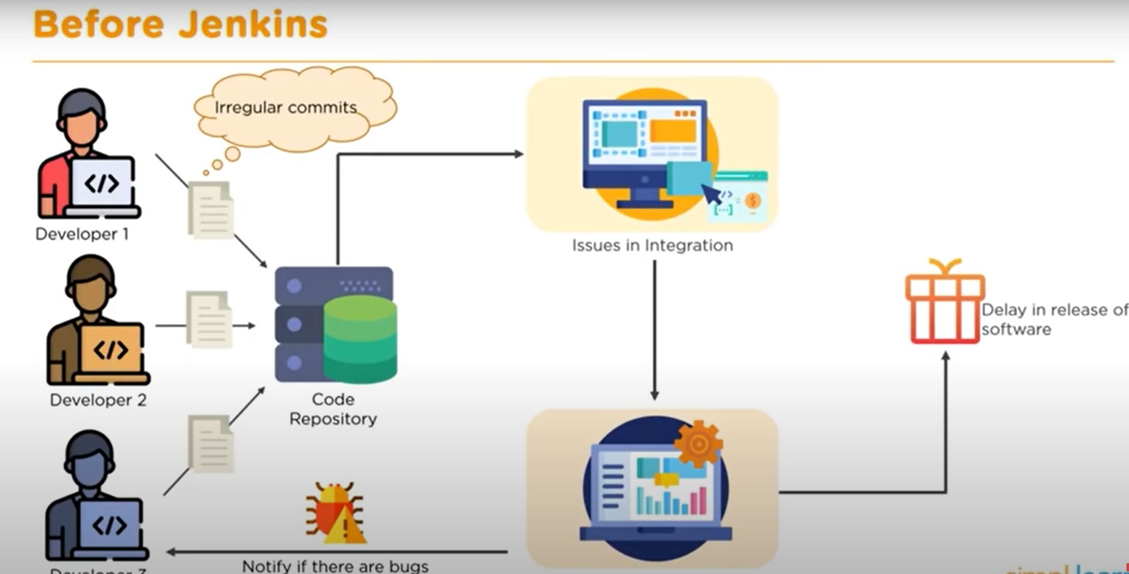
BEFORE JENKINS

Slide 6
HISTORY OF JENKINS
The Jenkins project was originally named Hudson, and was renamed in 2011 after a dispute with Oracle, which had forked the project and claimed rights to the project name. The Oracle fork, Hudson, continued to be developed for a time before being donated to the Eclipse Foundation. Oracle's Hudson is no longer maintained and was announced as obsolete in February 2017.

Slide 7
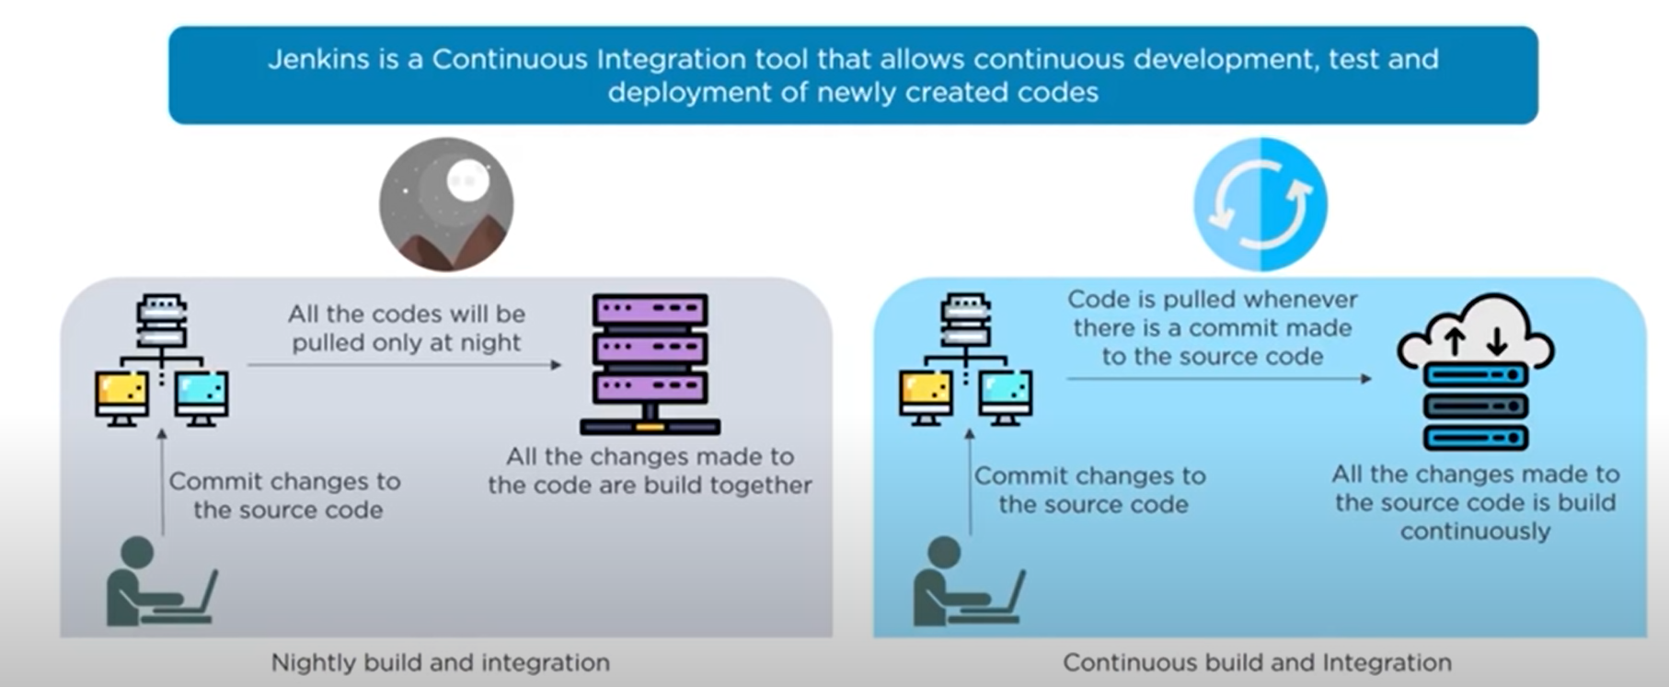
WHAT IS JENKINS

Slide 8
CONTINUOUS INTEGRATION
Continuous Integration is a development practice in which developers are required to commit changes to source code in a shared repository several times a day. Every commit is then build and this allows the teams to detect problems early.
It then bring following benefits to software development:
Catch issues fast and nip them in the bud.
Everyone can see what's happening.
Automate the build.
Continuous Integration leads to Continuous Deployment allowing us to deliver software more rapidly.

Slide 9
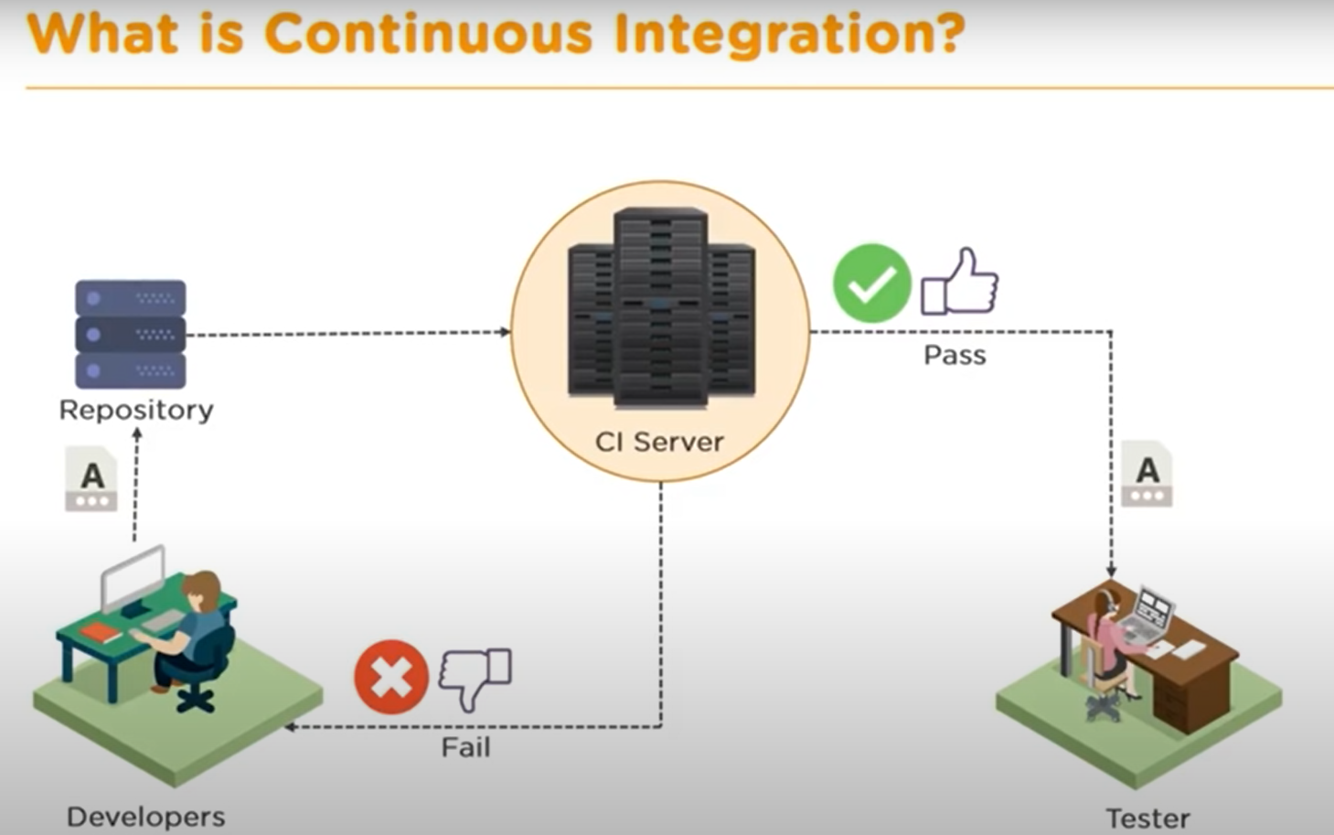

Slide 10
CONTINUOUS DELIVERY
Continuous delivery is a software development practice where code changes are automatically built, tested, and prepared for a release to production. It expands upon continuous integration by deploying all code changes to a testing environment and/or a production environment after the build stage. When continuous delivery is implemented properly, developers will always have a deployment-ready build artifact that has passed through a standardized test process.

Slide 11
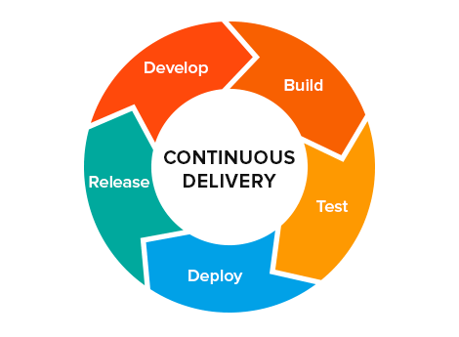

Slide 12
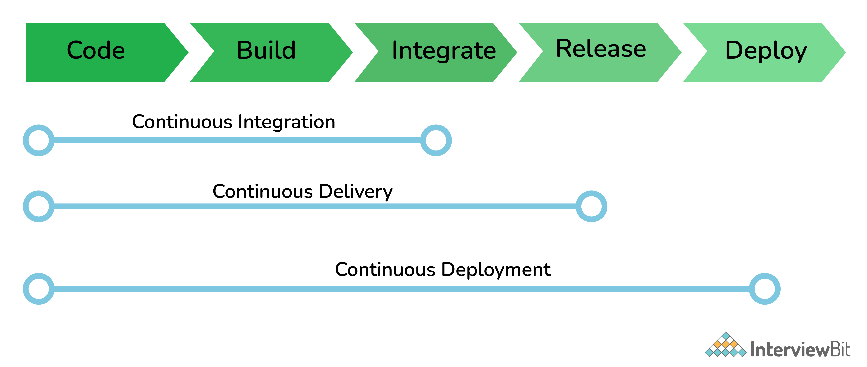

Slide 13
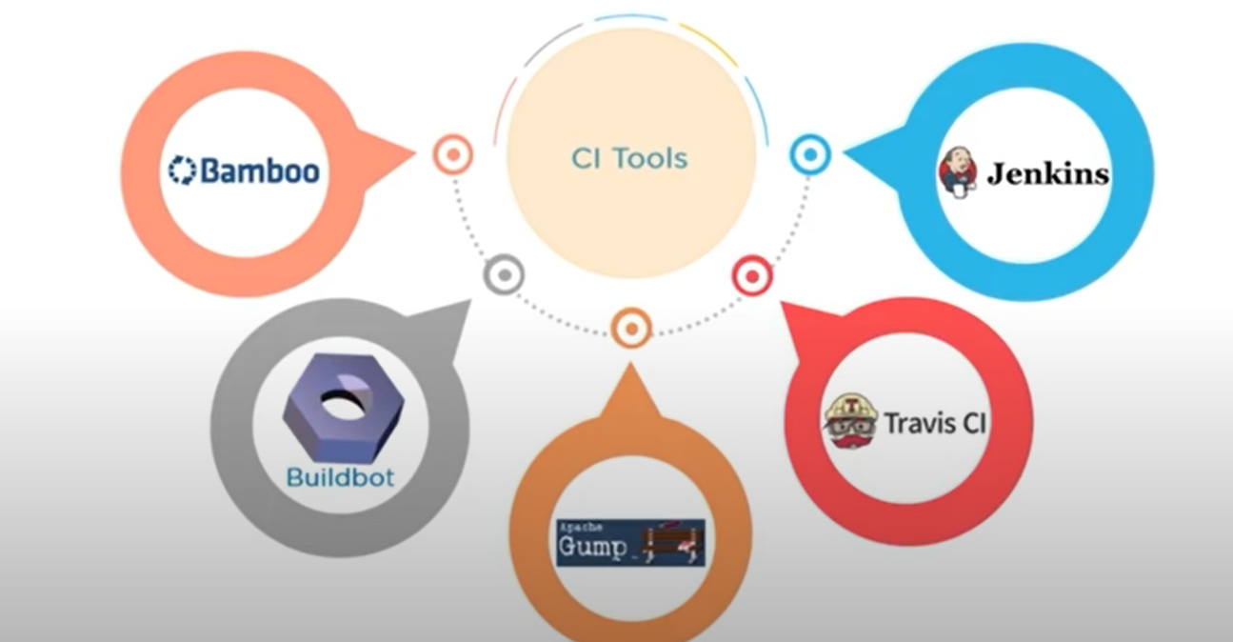
ALTERNATIVE TOOLS FOR JENKINS

Slide 14
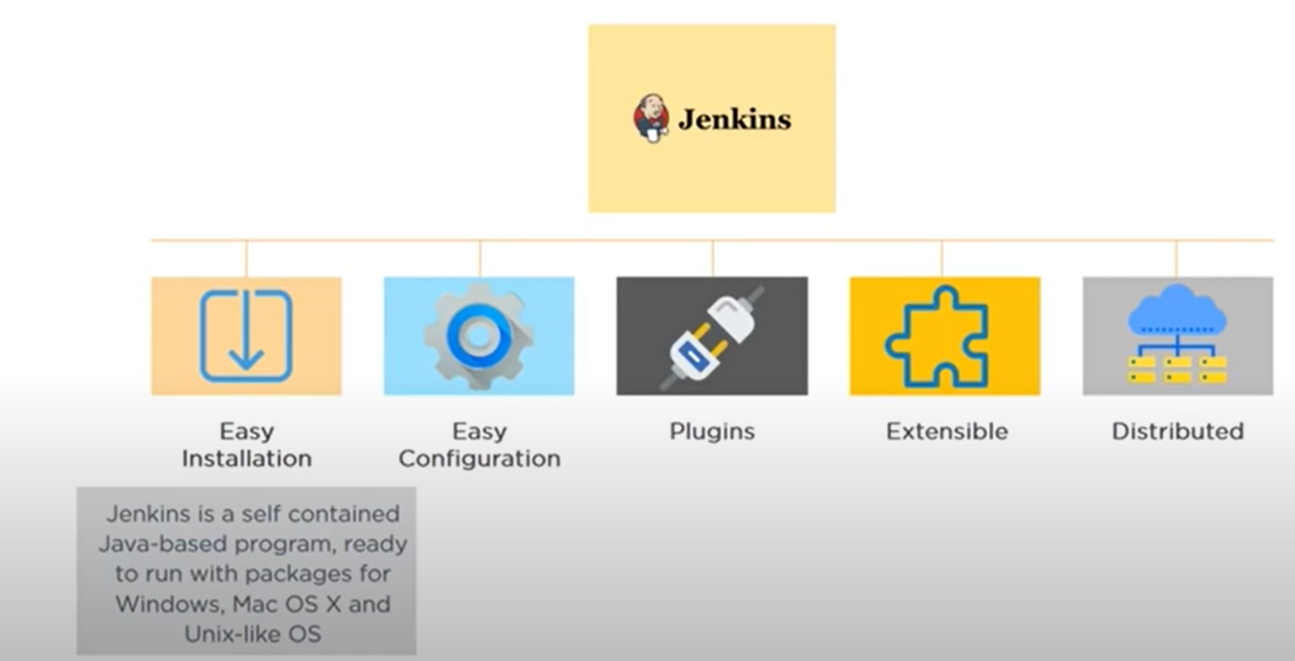
FEATURES OF JENKINS

Slide 15
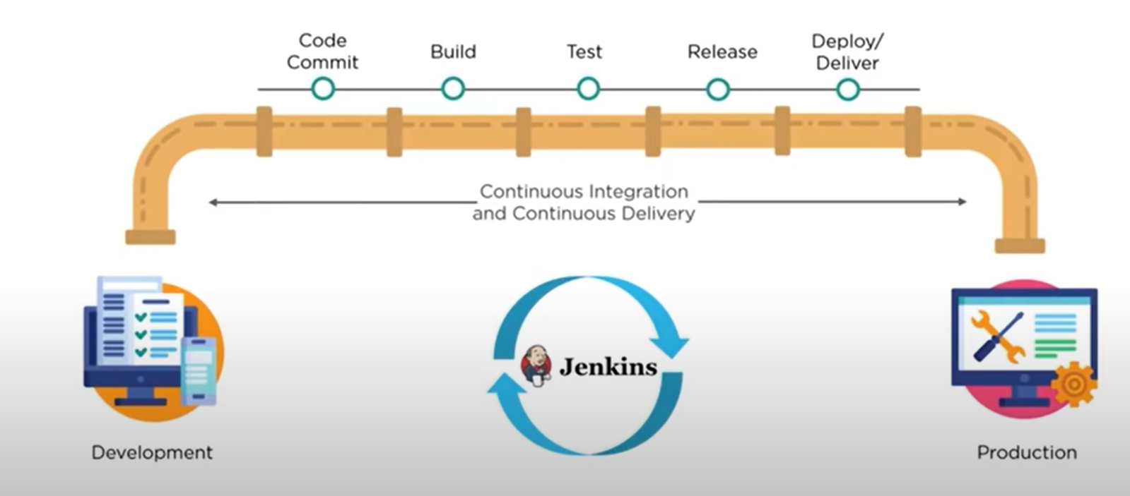
CI/CD PIPELINE

Slide 16
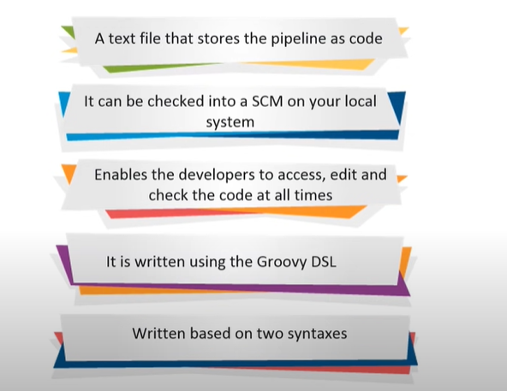
JENKINS FILE

Slide 17
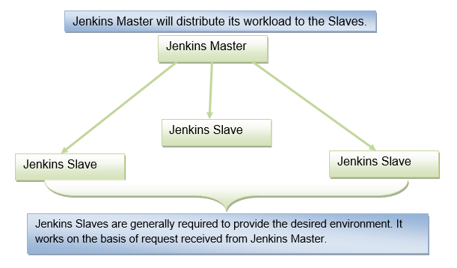
MASTER SLAVE ARCHITECTURE

Slide 18
Jenkins Master
The main server of Jenkins is the Jenkins Master. It is a web dashboard which is nothing but powered from a war file. By default it runs on 8080 port. With the help of Dashboard, we can configure the jobs/projects but the build takes place in Nodes/Slave. By default one node (slave) is configured and running in Jenkins server. We can add more nodes using IP address, user name and password using the ssh, jnlp or webstart methods.
The server's job or master's job is to handle:
Scheduling build jobs.
Dispatching builds to the nodes/slaves for the actual execution.
Monitor the nodes/slaves (possibly taking them online and offline as required).
Recording and presenting the build results.
A Master/Server instance of Jenkins can also execute build jobs directly.

Slide 19
Jenkins Slave
Jenkins slave is used to execute the build jobs dispatched by the master. We can configure a project to always run on a particular slave machine, or particular type of slave machine, or simple let the Jenkins to pick the next available slave/node.

